Slide 1
Astrosage Analysis
“A Data-Driven Evaluation of AstroSage Platform Insights To provide better service in future… ”
by neelam Rajput

Slide 2
Introduction and objectives
Most of the user did the repeat calls i.e. about 57% , which shows major efficiency gaps.
Objectives :-
Identifying the workload and performance gaps.
Identifying the better consultation type .
Recommend data-driven strategies to improve the overall efficiency.

Slide 3
Overview of data
Dataset :-28027 consultation records of 34 days .
Attributes :- 35 columns are provided in data having call details.
Time Duration :- 1st December 2023 to 3rd Jan 2024.
Scope of Analysis:-
Addition of new users and revenue earned.
Performance of Gurus and workload distribution.
Feedback analysis.
Preference of consultation type by user and call status.

Slide 4
Methodology
Analytical approach:
Cleaned data by removing duplicates, filling blank values, inserting the required columns. Created pivot tables to summarize data. Visualized the summarized data with help of chats and graphs. Identifying the major KPIs (agent,cost, rating and callvolume ). Derived insights for better utilization of investment. Tools used:
Excel( data cleaning, pivot table ,charts, formatting) Functions (COUNT,AVERAGE,SUM,CORREL) presenting everything in dashboard with slicers

Slide 5
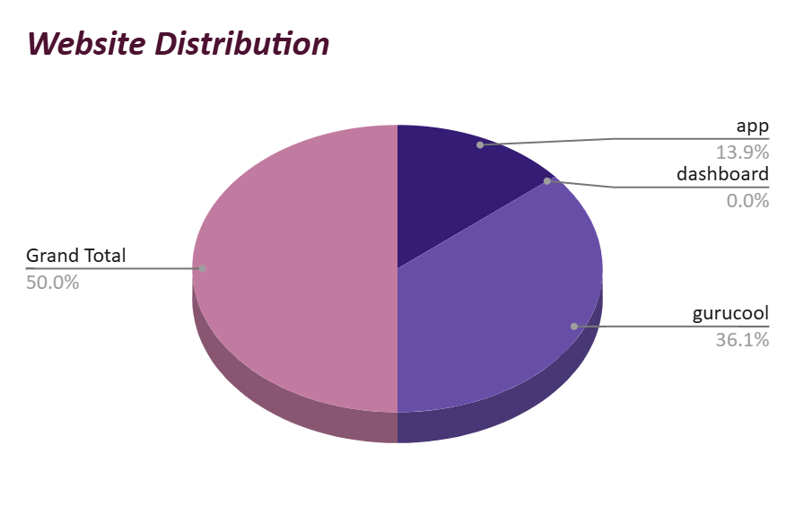
User access source
More than 72% of users use gurucool to connect to astrosage.
Using the mobile app is second most preferred choice.
Via dashboard the engagement of user is minimal.

Slide 6
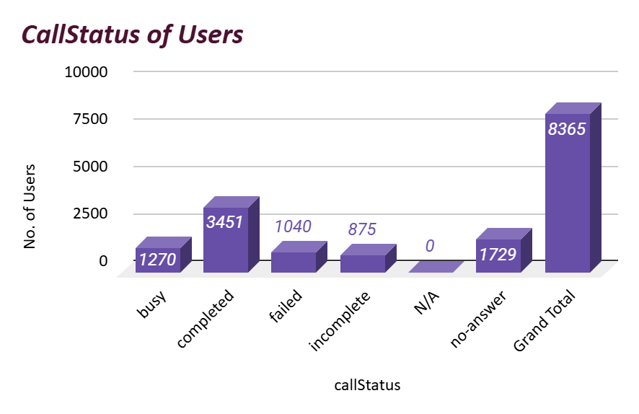
Call handling efficiency
About 3451 calls are successfully completed which is about 41% of total calls made.
While 1040 calls failed and 1729 were not answered contributing together approx. 35% indicating the need for improving the call handling efficiency.

Slide 7
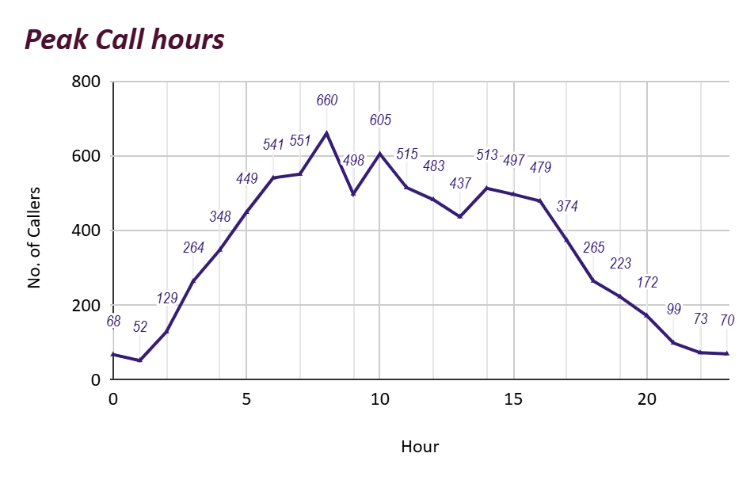
Peak timings of rush
Customer activity peaks after 6A.M. and remain engaged till 5P.M.
Hence the need of more agent is required during the interval .
Expert agents can be provided during these slots to handle the rush

Slide 8
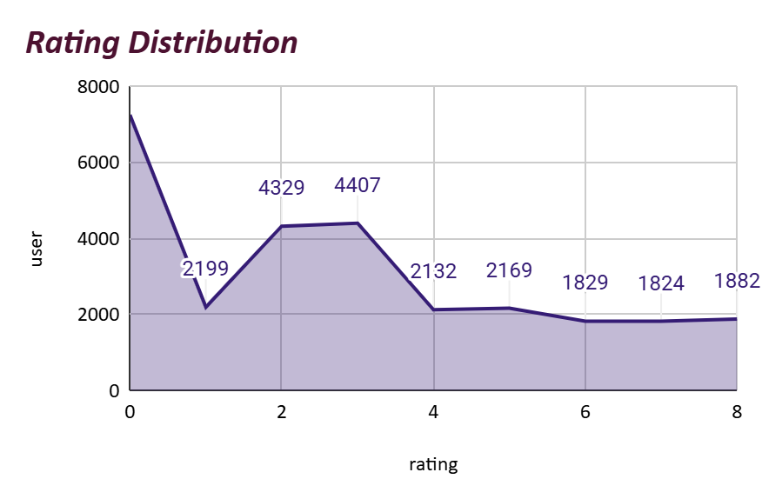
Performance of guru
Only two gurus were rated 7.5 on an average scale out of 150 gurus (i.e. Tarot mystical and Astro Pujaa Rai).
Some calls are even rated zeroes indicating the highly disappointing performance by agents.
Training should be given to unskilled staff.

Slide 9
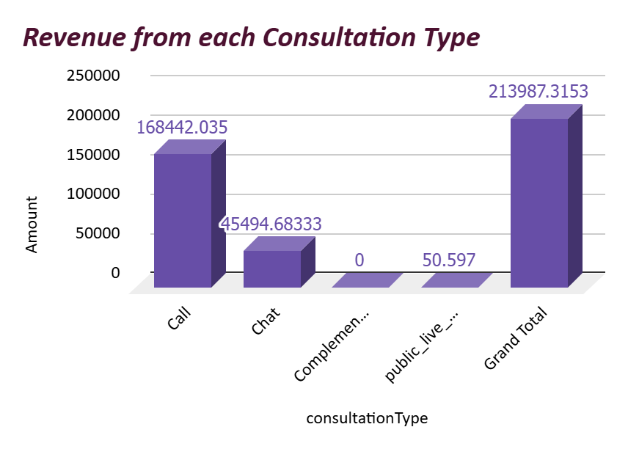
Earning’s of astrosage
Calls make the highest earning around Rs.1,68 lakhs.
Chats generate a decent amount of revenue around Rs.45K.
While public live calls has negligible and complementary calls have no contribution at all.

Slide 10
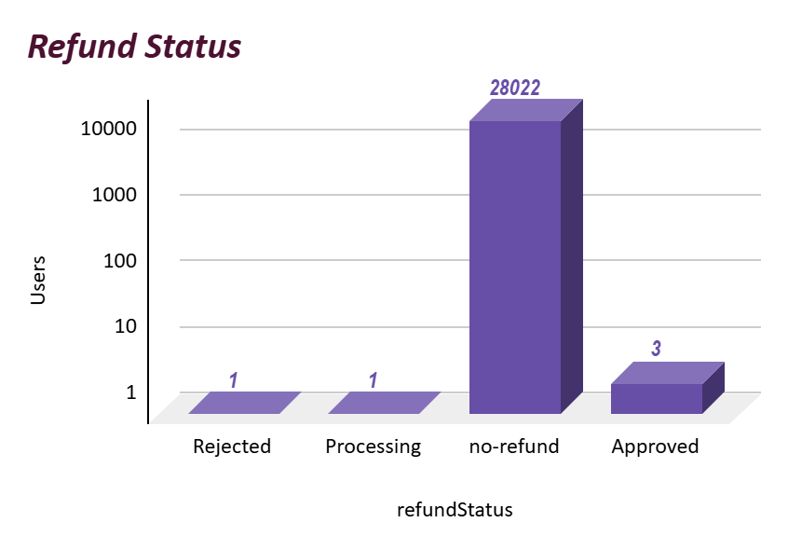
Refund Status
People asking for refund seems very low that seems good for the astrosage’s earning .
Problems are likely being resolved without needing refunds.

Slide 11
conclusions
After analyzing the data records only the key gap revealed was the number of calls made by the repeat callers i.e.about 4879 calls were made 1275 repeat callers out of 8508 call.
High number of sessions were rated 3 or below representing the dissapoinment among users. Even some gurus got rated well too proving their skills .
Investing in new technology ,training and incentives will surely improve the overall performance of astrosage.

Slide 12
Recommendations
Invest in Technology Upgrades: Improve call routing, IVR, and CRM systems to raise completion and FCR rates.
Optimize Workforce Utilization: Rebalance workloads, schedule efficiently, and share best practices from top performers.
Enhance Training & Incentives: Focus on empathy, communication, and problem-solving to boost CSAT and retention.
Performance monitoring: use live dashboards to keep eye on the performance of agents.

Slide 13
Thank you
By Neelam Rajput
04-01-2026

